Slide 1
Literature search and data compilation
Minghua Shen
Email: minghua.shen@idiv.de
31/08/2024 Shanghai

Slide 2


DATA

Slide 3


DATA

Slide 4
How to search
Tools to improve the recall and precision
Data management

Slide 5
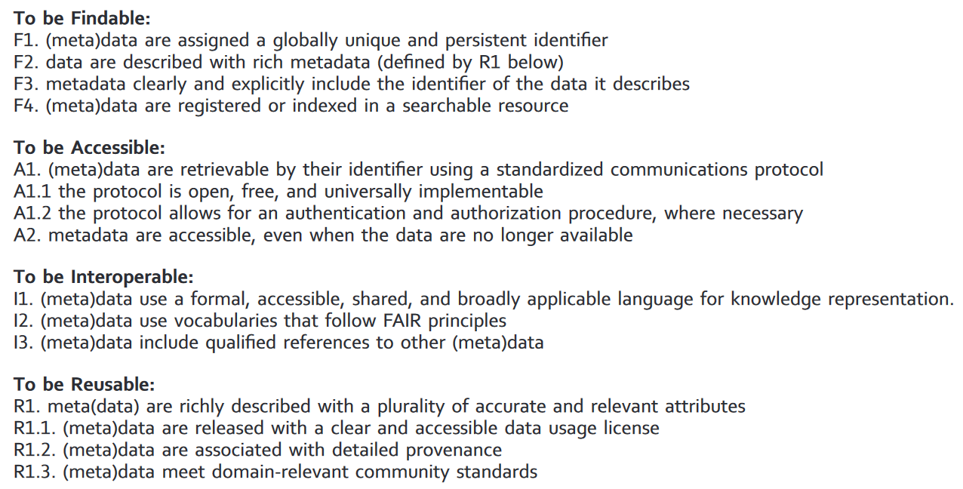
The FAIR Guiding Principles for scientific data management and stewardship
Wilkinson et al., 2016
Notes:
Reproducibility is made possible through a high degree of transparency when reporting the planned or final methods used in a review protocol or final report. Reporting standards, such as PRISMA (Preferred Reporting Items for Systematic reviews and Meta‐Analyses)

Slide 6
Reporting standards
Evidence syntheses (e.g., systematic reviews and evidence maps) typically aim to reliably synthesise an evidence base, and are based on state‐of‐the‐art methodologies designed to maximise comprehensiveness (or representativeness), procedural objectivity, and reproducibility, whilst minimising subjectivity and risk of bias.
Haddaway et al., 2022
Notes:
Reproducibility is made possible through a high degree of transparency when reporting the planned or final methods used in a review protocol or final report. Reporting standards, such as PRISMA (Preferred Reporting Items for Systematic reviews and Meta‐Analyses)

Slide 7
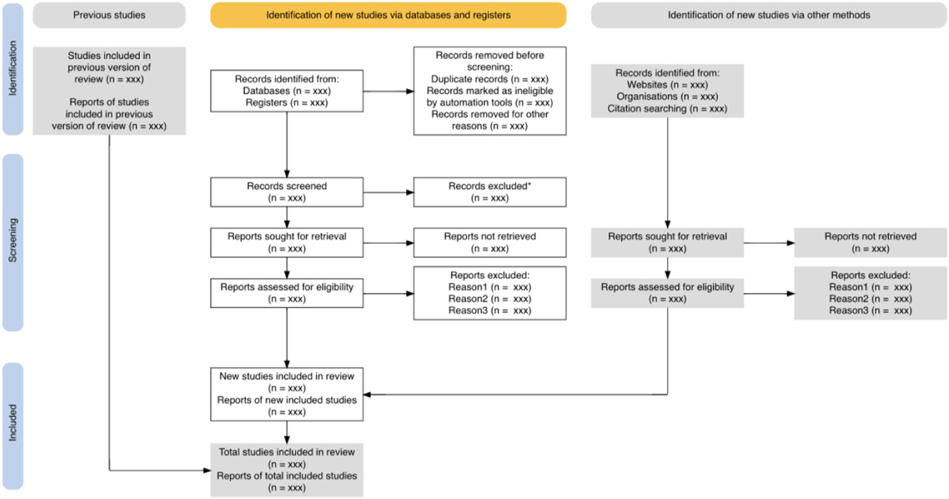
Reporting standards PRISMA: Preferred Reporting Items for Systematic reviews and Meta-Analyses
Haddaway et al., 2022

Slide 8
Reporting standards PRISMA: Preferred Reporting Items for Systematic reviews and Meta-Analyses
Haddaway et al., 2022

Slide 9
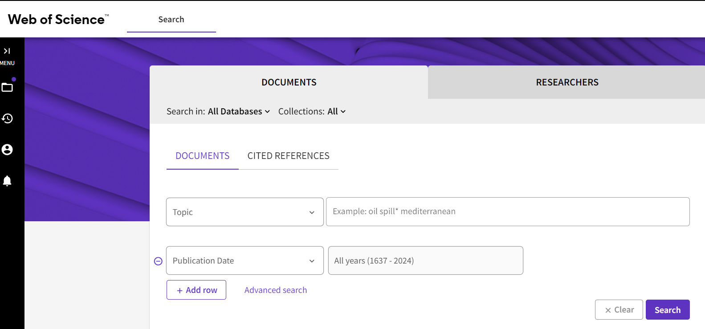
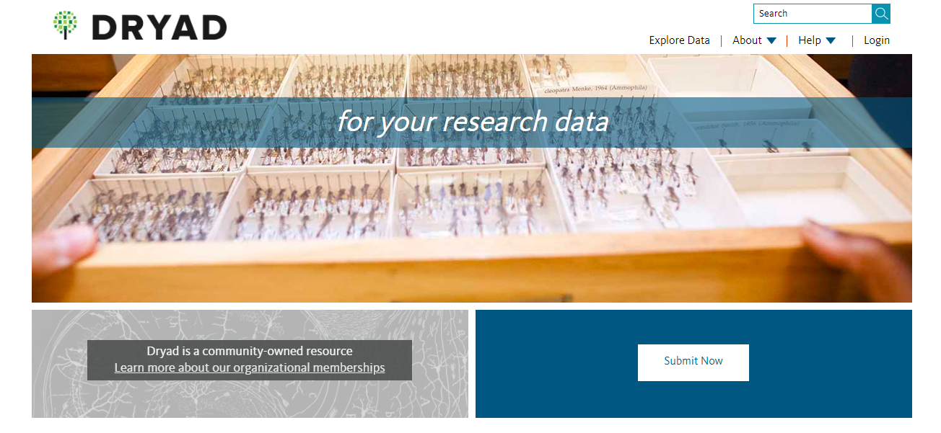
Search resources
Literature: Web of science; Google Scholar
Repository: Dryad

Slide 10
Search resources
Literature: Web of science; Google Scholar
Repository: Dryad

Slide 11
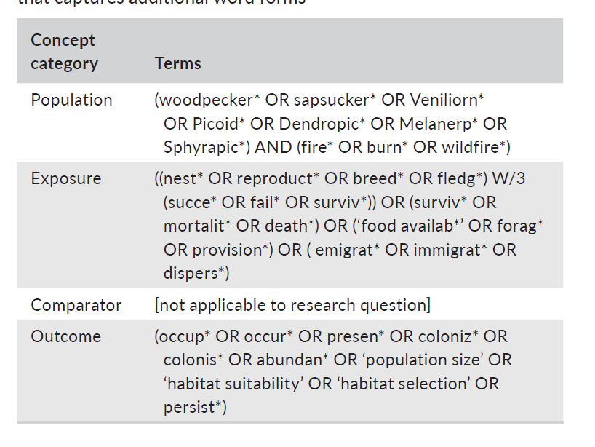
Choose search terms
The most important part to find relevant literature
Do a broad literature search first to get a quick overview of the topic
Group your search terms according to PICO/PECO
Haddaway et al., 2016; Grames et al., 2019

Slide 12
Relevant keyworkds
Consider which relevant terms you should include
Broader terms: richness – biodiversity…
Narrower terms: species – plants, birds…
Synonyms: elevation – altitude…
Notes:
we need to consider the relevant terms with those we know.

Slide 13
Truncation, wild card & phrase search
Truncation (e.g. *) used to search different word endings
e.g. use comput* to find computer, computers, computed, computing, etc.
Wild Cards (e.g. ?) used to search for spelling variants
e.g. use colo?r to find color and colour
Phrase search (“ ”) used to search for precisely the text you have written
e.g. “species richness”
Notes:
Truncation (asterisk ) refers to the use of wildcard symbols, e.g. * or ?. Truncation symbols replace one or more letters and are most often placed at the end of your keywords. They can however also be placed in the middle of a keyword or, in some databases, at the beginning of a keyword.
Masking is a specific form of truncation where you replace one single letter in a keyword with a masking symbol. Masking is usually used in the middle of a keyword:
Phrase search is used when you want to ensure the database searches for precisely the text you have written. You can do this by placing one or more words in quotation marks. Phrase search is particularly good for composite terms.
You can also use some tips/techniques to make the keywords as complete as possible.

Slide 14
Search strategy – Boolean operator
OR: use to combine terms within the same concept
AND: use to combine together different concepts
NOT: use to exclude terms from your search
OR
AND
NOT
A
B
A
B
A
B
A OR B
A AND B
A NOT B
Notes:
You can state the relationship between your search words by using the so-called Boolean operators. These operators are the three words: “and”, “or”, and “not”.
And – finds the results in which both words occur: Learning AND education
Or – finds the results in which only one of the words occurs: Learning OR education
Not – finds the results in which the first word occurs but not the second one: Learning NOT education.

Slide 15
More than two words
A
B
A
B
C
C
(A AND B) OR C
A AND (B OR C)
When more than two terms are combined with different boolean operators, use parenthesis to group or nest terms
Notes:
But the keywords are grouped in different ways with parenthesis, we can get different results.

Slide 16


Research question (example)
VS
Monet, Renoir, Munch

Slide 17
Research question (example)
VS
Monet, Renoir, Munch

Slide 18






Research question (example)
VS
Monet, Renoir, Munch

Slide 19

The keywords you want to use for the example research
https://www.menti.com/al3dfvj19ez3

Slide 20

Tools to improve the recall and precision
Citation networks
High precision, predetermined articles
Recall
Precision
Text mining
High recall, predetermined articles
Litsearchr
Search strategy
High recall and precision, without predetermined articles.
Using text mining and keyword co‐occurrence networks to identify the most important terms for a review automatically.
Grames et al., 2019

Slide 21
Tools to improve the recall and precision
Citation networks
High precision, predetermined articles
Recall
Precision
Text mining
High recall, predetermined articles
Litsearchr
Search strategy
High recall and precision, without predetermined articles.
Using text mining and keyword co‐occurrence networks to identify the most important terms for a review automatically.
Grames et al., 2019

Slide 22
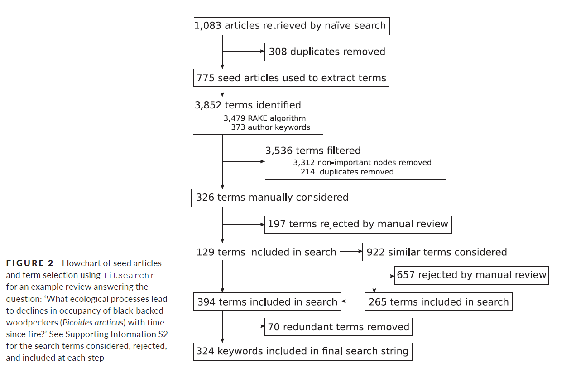
Litsearchr
Grames et al., 2019

Slide 23

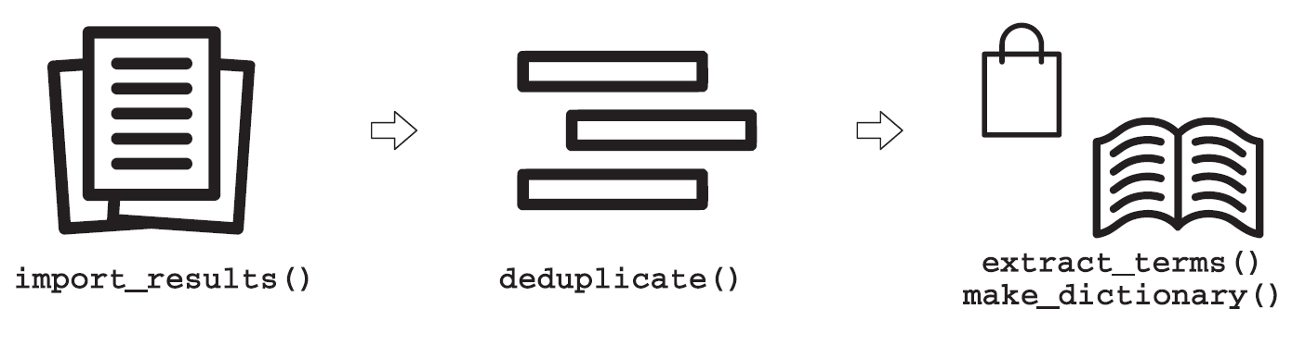
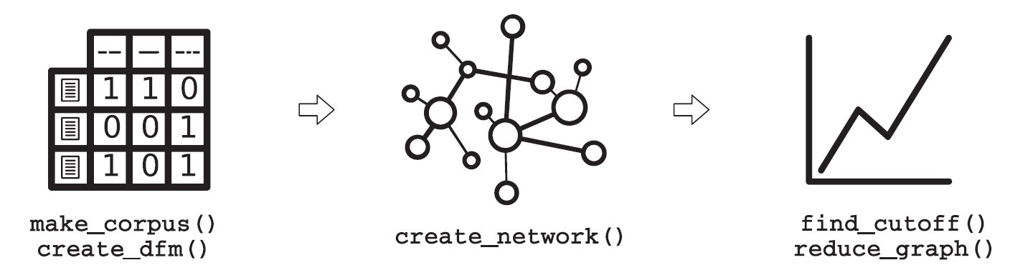


How to use it
1. Research team writes a naïve search to get a set of relevant articles.
2. Import search results into litsearchr and remove duplicates. Litsearchr creates a dictionary of possible search terms.
3. Litsearchr creates a matrix with each possible search term from the dictionary and the matrix becomes networks. Litsearchr fits a model to the network to find a cutoff by importance.
4. Litsearchr suggests possible search terms. Research team manually considers about them.
5. Litsearchr can translate other language terms into user-specified language.
Grames et al., 2019

Slide 24
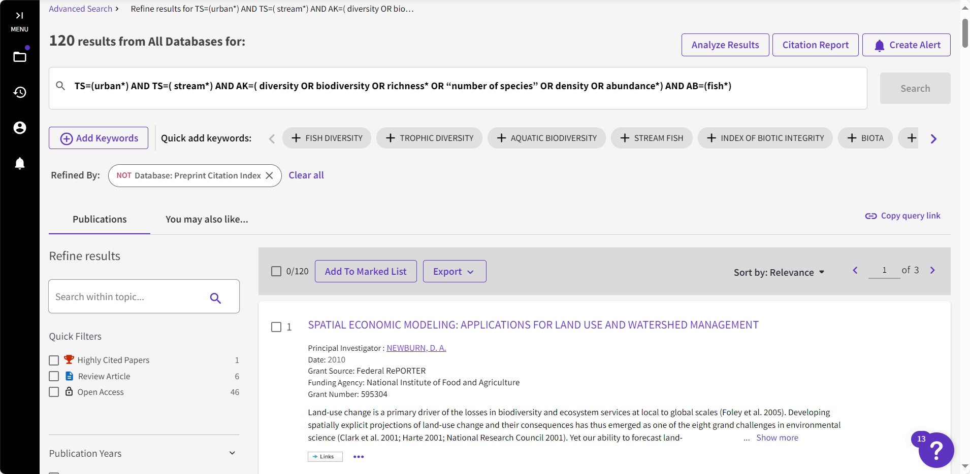
Search Terms
TS=(urban*) AND TS=( stream*) AND AK=( diversity OR biodiversity OR richness* OR “number of species” OR density OR abundance*) AND AB=(fish*)
Export all keywords, titles, abstracts

Slide 25
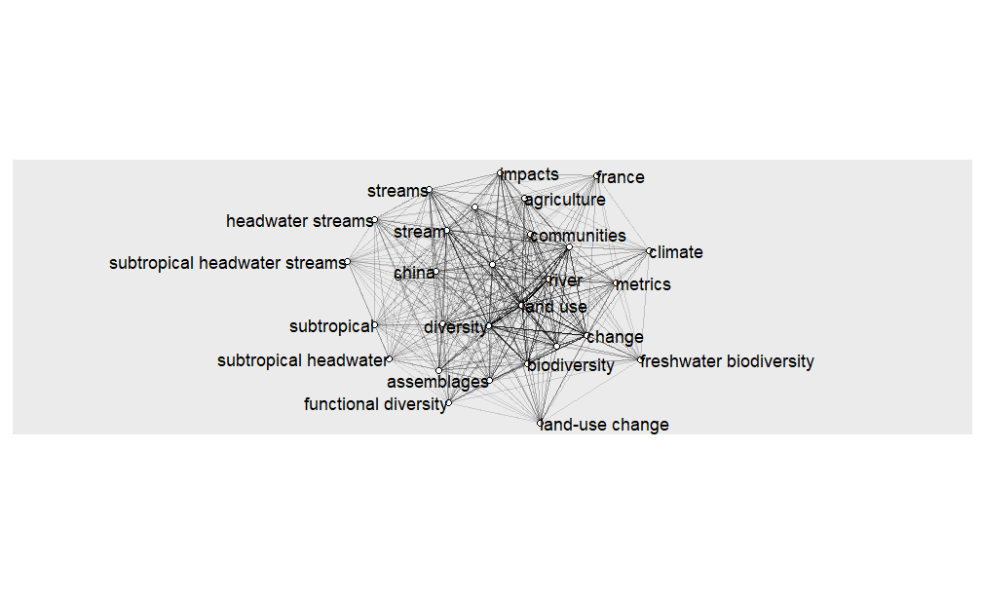
Search Terms (exercise)
Network of terms
Notes:
See the code

Slide 26
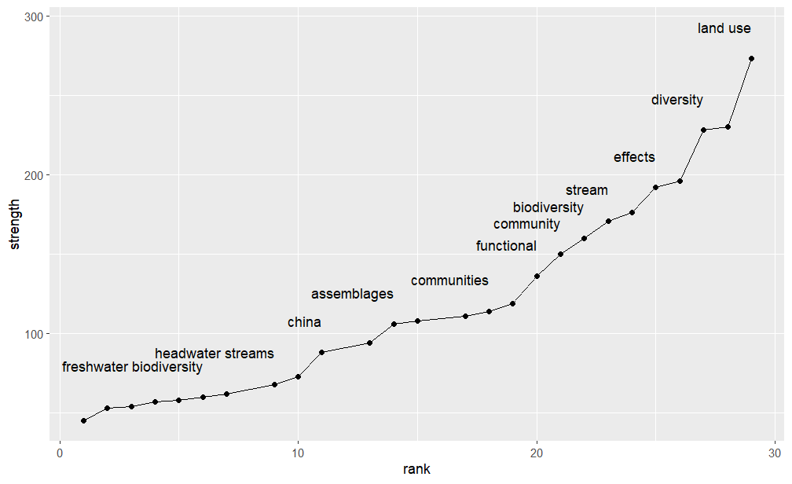
Search Terms (exercise)
Network of terms
Rank terms by strength
Notes:
See the code

Slide 27
Search Terms (exercise)
Notes:
See the code

Slide 28
Search Terms
TS=(urban*) AND TS=( stream*) AND AK=( diversity OR biodiversity OR richness* OR “number of species” OR density OR abundance*) AND AB=(fish*)

Slide 29
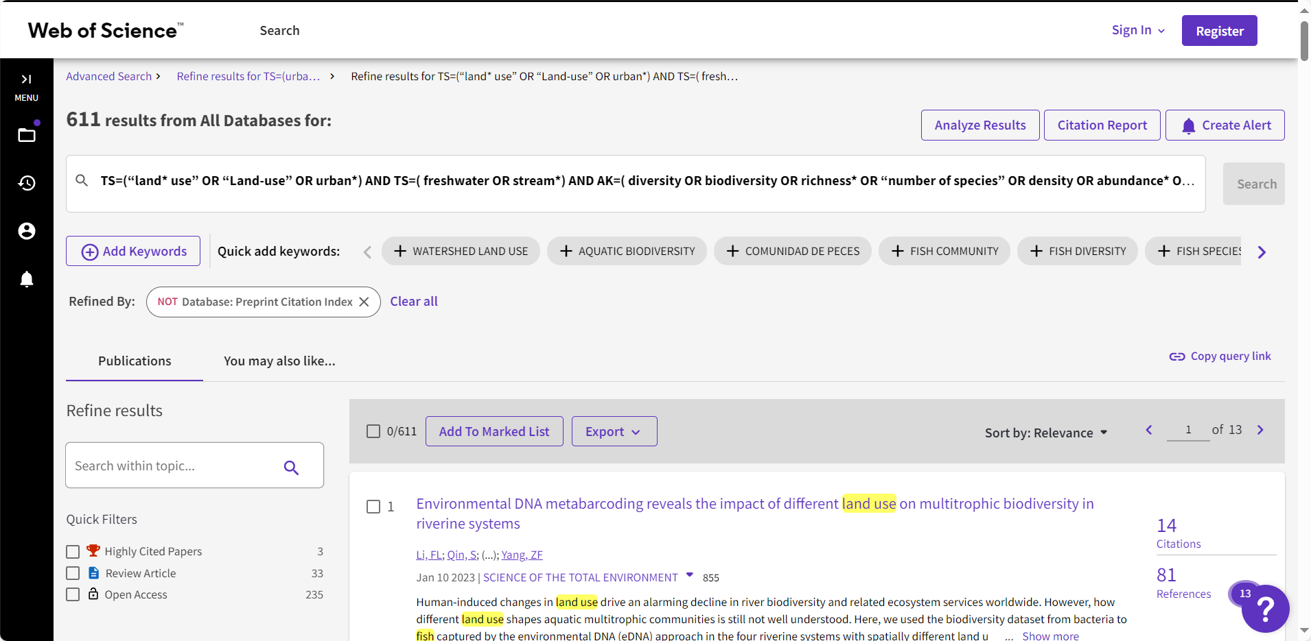
Search Terms
TS=(“land* use” OR “land-use” OR urban*) AND TS=( freshwater OR stream*) AND AK=( diversity OR biodiversity OR richness* OR “number of species” OR density OR abundance* OR communit* OR assemblge*) AND AB=( fish*)
Notes:
Facilitate quick, objective, reproducible search strategy.
Reduce the amount of human time and effort needed to conduct a systematic review.
Reduce bias in keywords selection when researchers develop search strategies.
Search in 53 different languages, with stemming support for English.
Assess the quality of a search results.

Slide 30
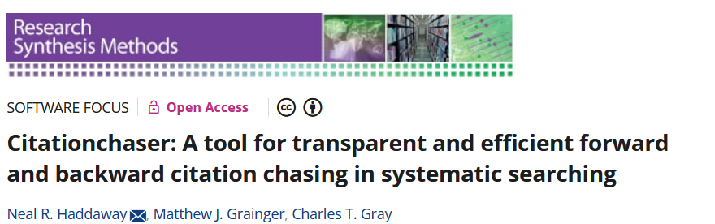
Citationchaser

Slide 31
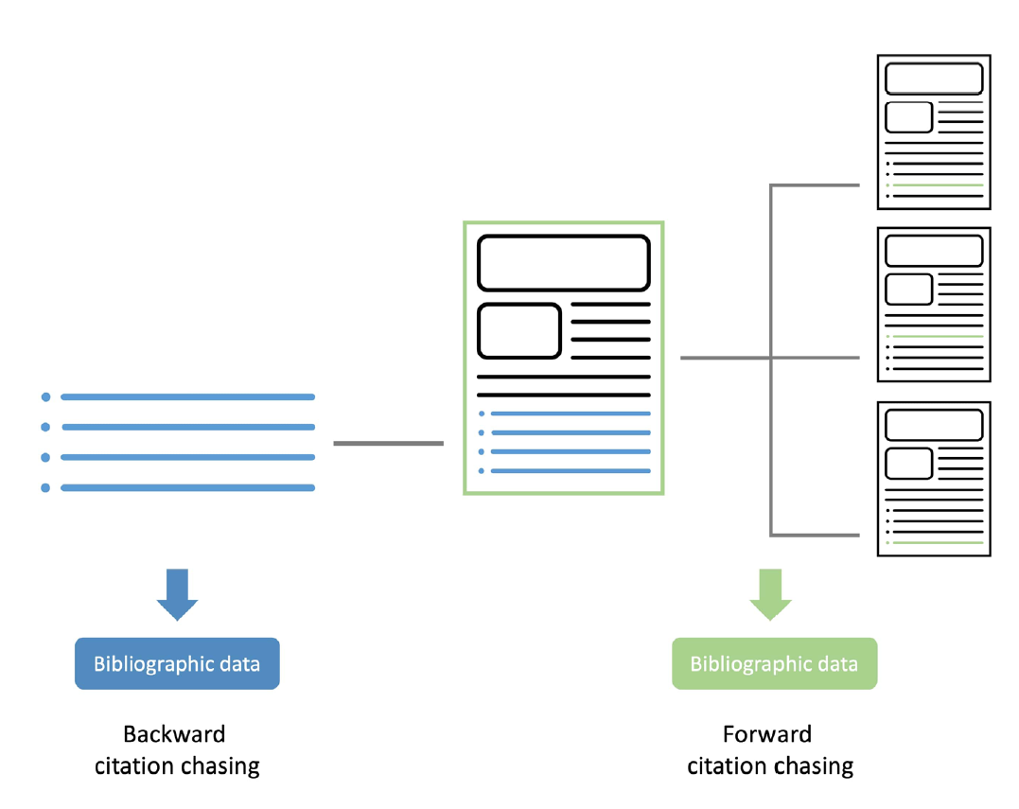
Citationchaser
Older literature: check references of a specific relevant article
Newer literature: use the information about which later articles cite a specific relevant article.
Haddaway et al., 2022

Slide 32
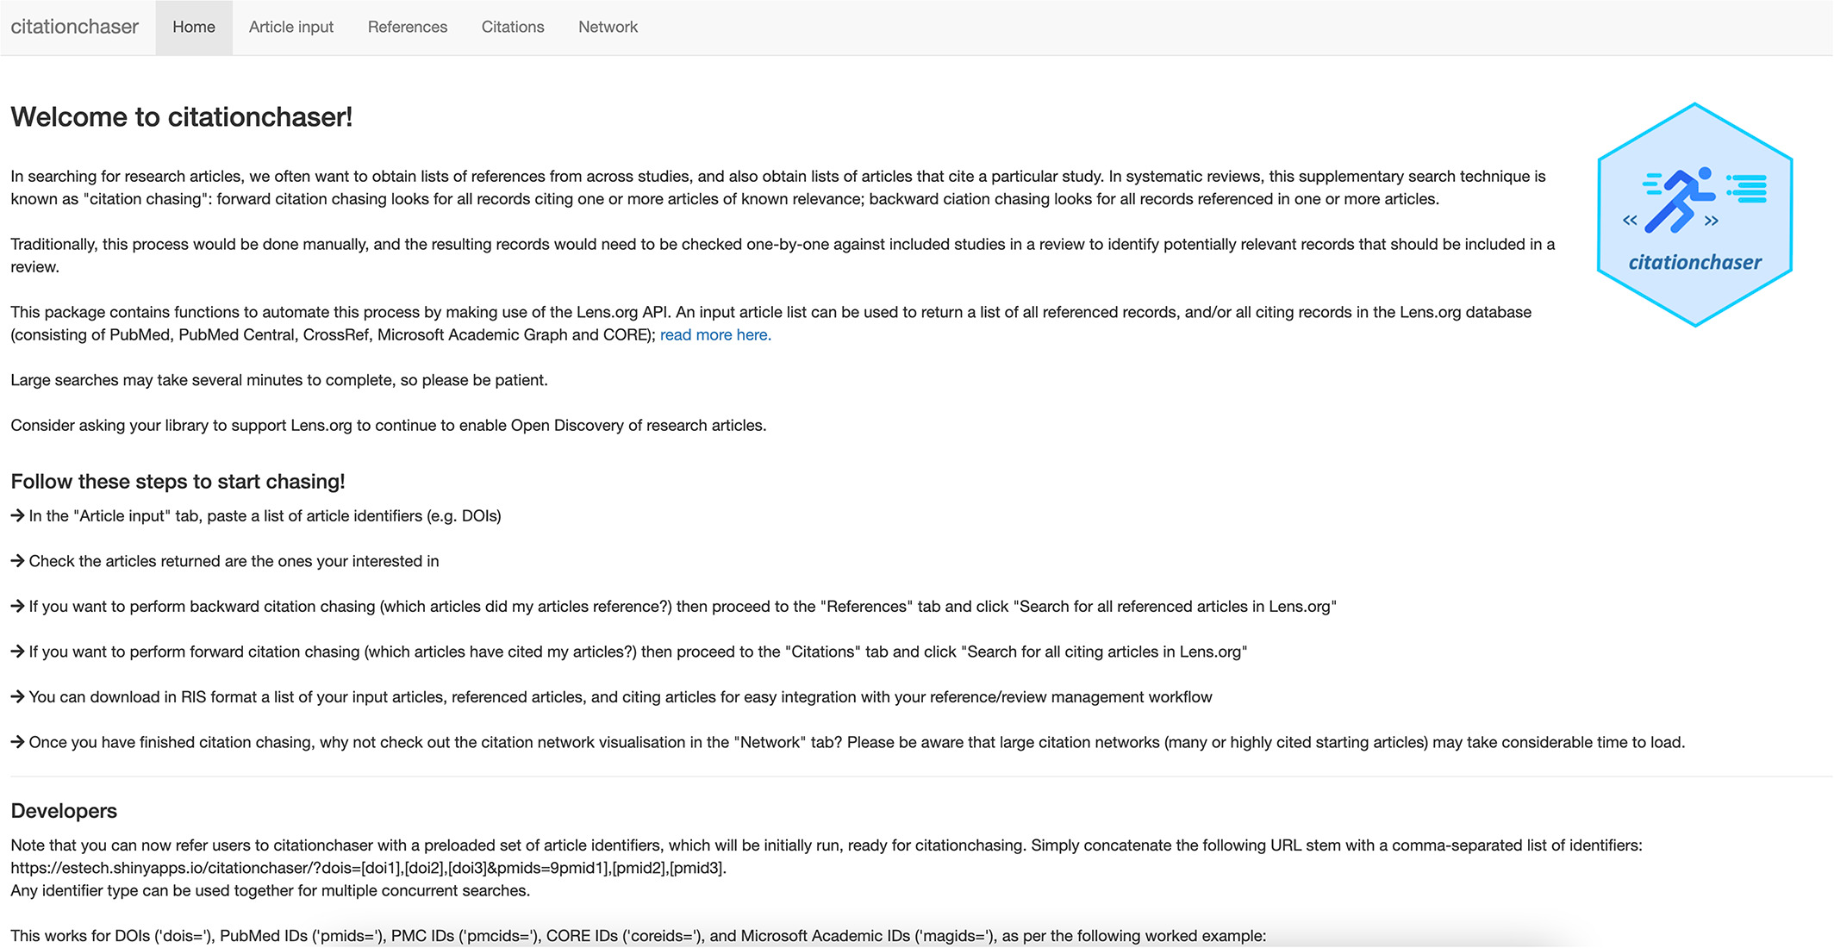
Citationchaser
R studio (Token needed)
Local Shiny app
https://estech.shinyapps.io/citationchaser

Slide 33
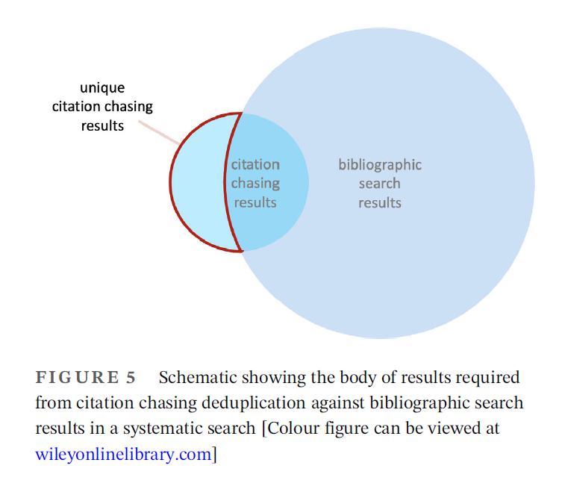
Citationchaser
Haddaway et al., 2022

Slide 34
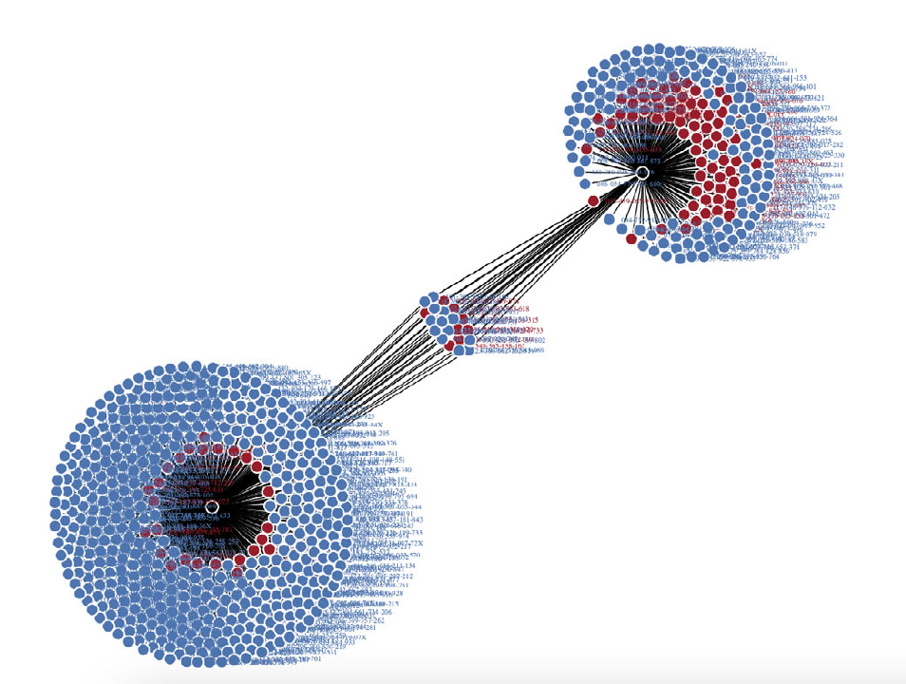
Citationchaser
Haddaway et al., 2022

Slide 35
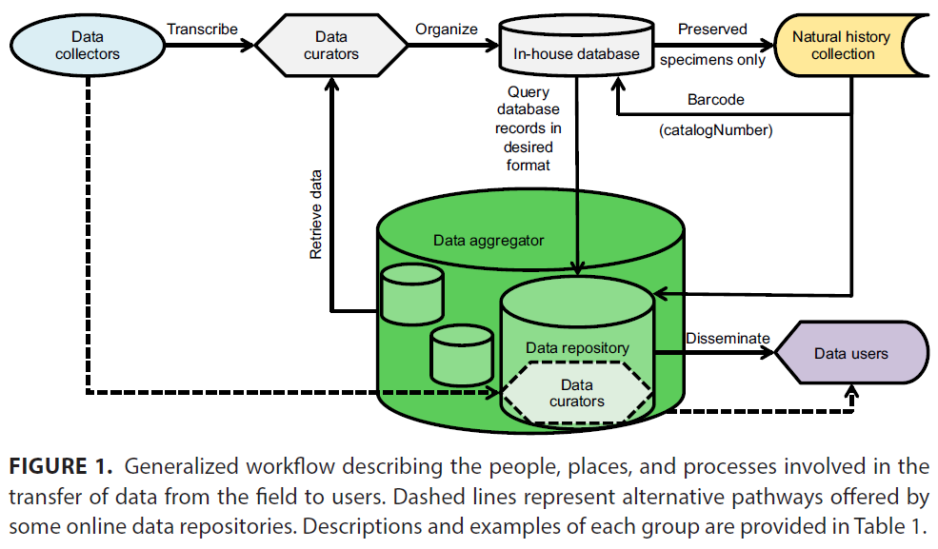
Data management
Hackett et al., 2019

Slide 36
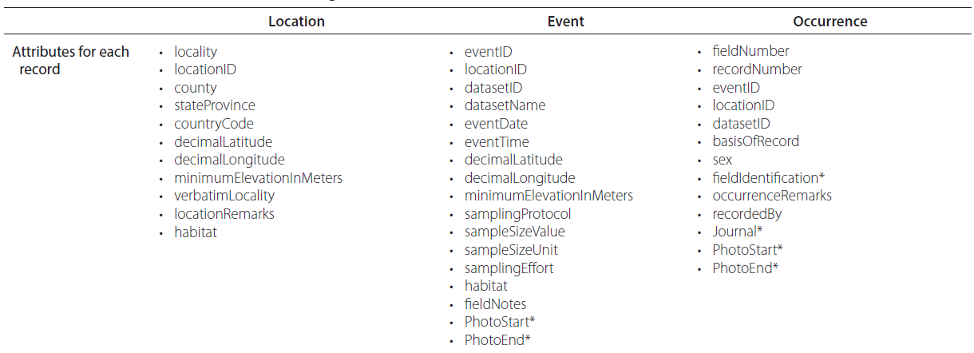
Record level
Hackett et al., 2019

Slide 37
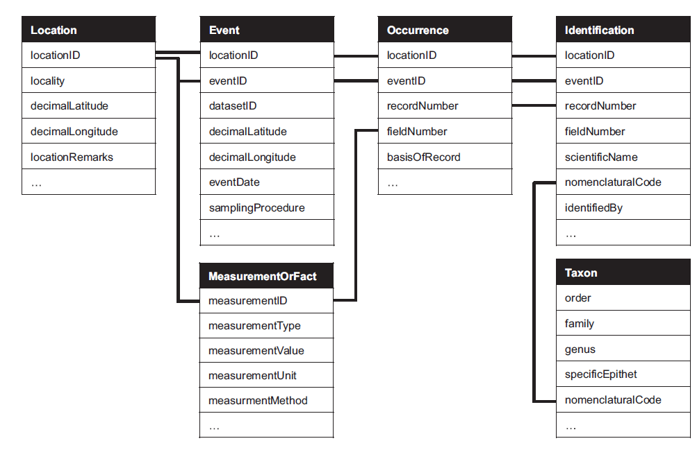
How to structure it?
Hackett et al., 2019

Slide 38
Research question (example)
VS
Monet, Renoir, Munch

Slide 39

What data do we need?
https://www.menti.com/alwtoe6bg386

Slide 40
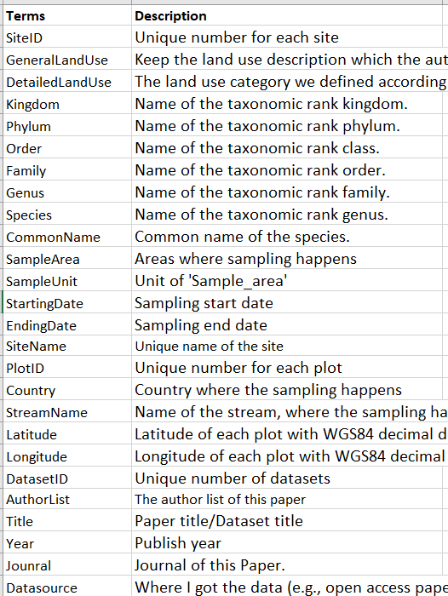
Exercise—How to structure the data below?
Define the record levels.
Connect data at different record levels.

